Slide 1
What is the backdrop for our work?
Watanabe, JH, McInnis, T, & Hirsch, JD. “Cost of Prescription Drug–Related Morbidity and Mortality.” Annals of Pharmacotherapy, 2018; 52(9), 829–837.
American College of Clinical Pharmacy (ACCP). Comprehensive Medication Management in Team-Based Care. https://www.accp.com/docs/positions/misc/CMM%20Brief.pdf
1

Slide 2

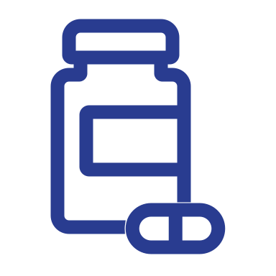



We believe….
A personalized, patient-centered, systematic and coordinated approach to medication use will vastly improve outcomes and reduce overall health care costs.
We must align systems of care to integrate comprehensive medication management, engaging patients to ensure that they are willing and able to take those medications that are indicated, effective, and safe, to optimize their outcomes.
We need immediate delivery system, payment, and policy transformation to streamline clinical trials and reduce costs of bringing drugs to market while enabling successful, broad-scale adoption of integrated, comprehensive medication management (CMM) services.
Appropriate diagnosis and access to advanced diagnostics with companion/complementary and pharmacogenetics (PGx) testing is essential to target correct therapy.
Success requires team-based, patient-centered care models that recognize appropriately skilled clinical pharmacists as medication experts who work in collaborative practice with physicians and other providers.
2

Slide 3
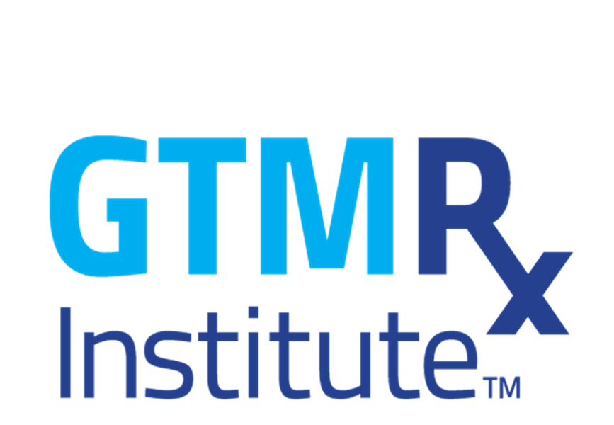
What is CMM?
A systematic approach to medications where physicians and pharmacists ensure that medications (whether they are prescription, non-prescription, alternative, traditional, vitamins or nutritional supplements) are individually assessed to determine that each medication is appropriate for the patient, effective for the medical condition, safe given the comorbidities and other medications being taken and able to be taken by the patient as intended.*
* McInnis, Terry, et al., editors. The Patient-Centered Medical Home: Integrating Comprehensive Medication Management to Optimize Patient Outcomes. 2nd ed. PCPCC Medication Management Task Force collaborative document.
3

Slide 4
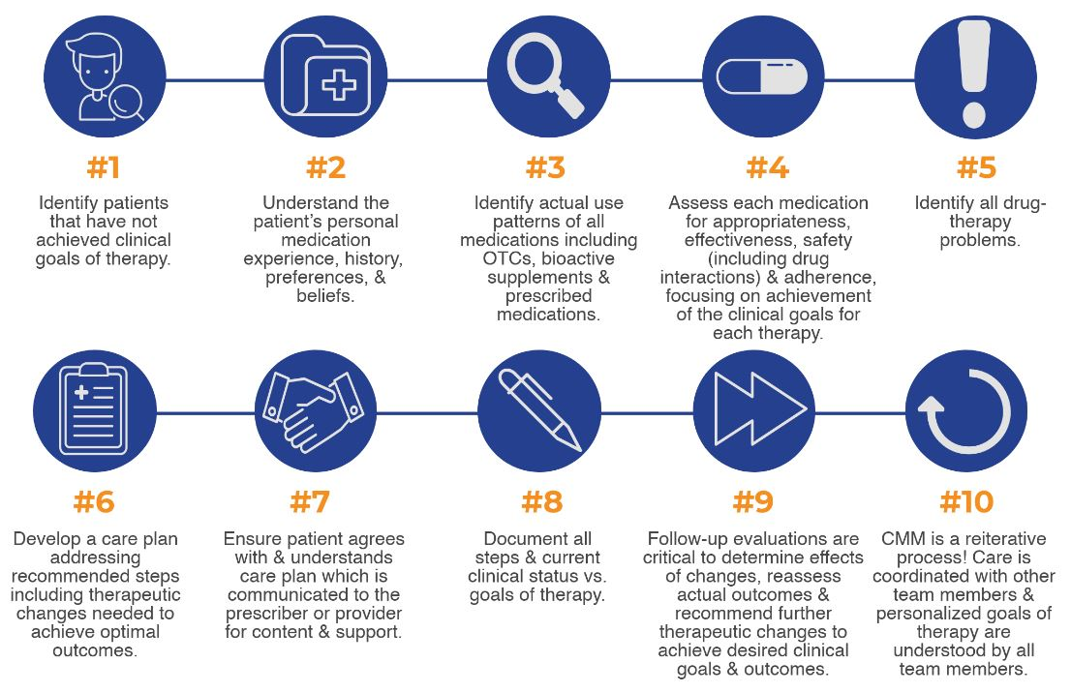
10 Steps to CMM:
4

Slide 5
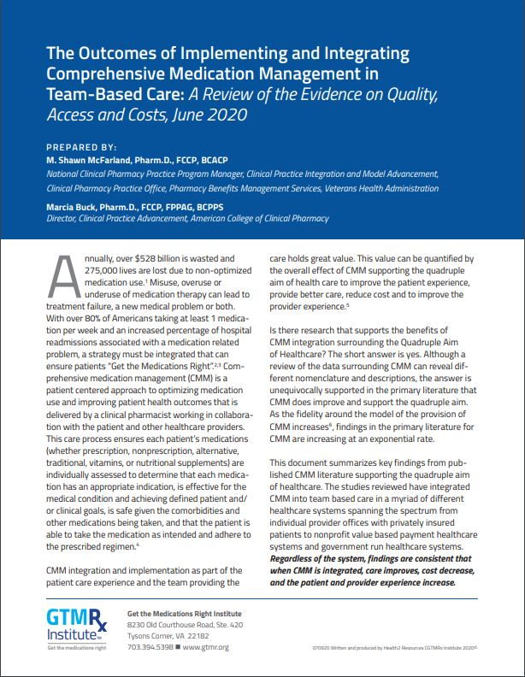
CMM is core to comprehensive primary care – and a medication use process that saves lives and money
The Outcomes of Implementing and Integrating Comprehensive Medication Management in
Team-Based Care
  • Better care
  • Reduced costs
  • Improved access to care
  • Improved provider work life
  • Improved patient satisfaction
  • Improved outcomes
  • Improved quality of care
5

Slide 6


Return on investment for CMM
The evidence supports comprehensive medication management
ROI around 3:1 to 5:1 & can be as high as 12:1
Savings: $1200 — $1872 per patient per year
It has been shown to:
improve the health of populations,
enhance the experience of care for individuals,
reduce the per capita cost of health care and
improve physician satisfaction.
Fulfills all four elements
of the Quadruple Aim:
improve clinical quality,
cost savings,
patient outcomes and
physician satisfaction.
6
Notes:
Practices around the country demonstrate the value-proposition for CMM each day.
ROI of team-based medication management services to average around 3:1 to 5:1 & can be as high as 12:1
Reduction in the direct mean medical cost of between $1200 and $1872 per patient per year for each of the first 5 years for those patients with chronic diseases
The evidence of its effectiveness continues to grow. It has been shown to improve the health of populations, enhance the experience of care for individuals, reduce the per capita cost of health care and improve physician satisfaction.
BOTTOM LINE: CMM works well when an integrated team functions cohesively. It fulfills all four elements of the Quadruple Aim: improve clinical quality, cost savings, patient outcomes and physician satisfaction.

