Slide 1
GTMRx National Task Force: Focused on Building Vaccine Confidence in the Health Neighborhood
Convened April – June 2021

Slide 2

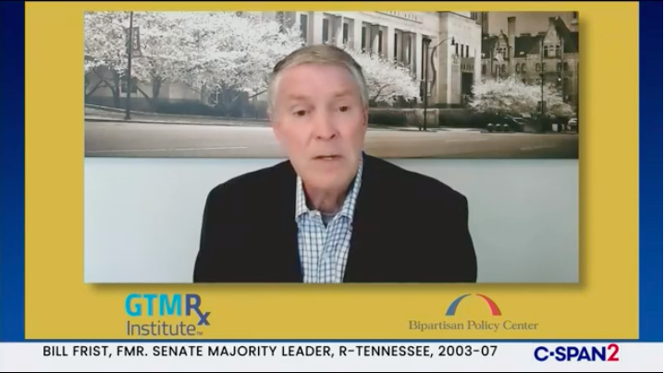
Background and Resources to Build Vaccine Confidence in the Health Neighborhood
On April 6, 2021, GTMRx and the Bipartisan Policy Center co-hosted national kick-off event.
GTMRx National Taskforce was announced and began work on a set of recommendations.
Background report and resources released as “level-setting” tool as the Task Force began their work.

Slide 3
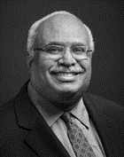

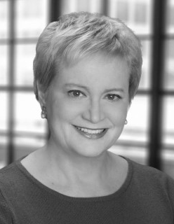

GTMRx National Task Force: Focused on
Building Vaccine Confidence in the Health Neighborhood
Task Force Leadership
Taskforce Co-Lead
Georges Benjamin, MD
Executive Director, American Public Health Association
Taskforce Co-Lead
Paul Abramowitz, Pharm.D., ScD (Hon), FASHP
CEO, American Society of Health-System Pharmacists
Taskforce Co-Lead
Susan Dentzer
Senior Policy Fellow, Robert J. Margolis Center for Health Policy, Duke University
Taskforce Staff Officer
Katherine Herring Capps
Co-Founder & Executive Director
GTMRx Institute

Slide 4

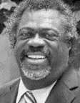

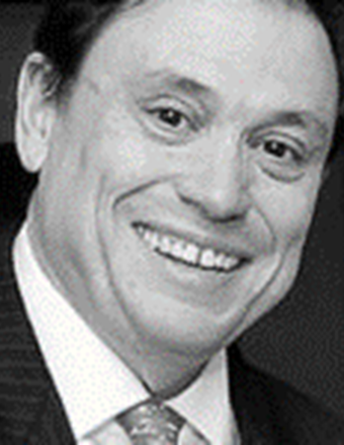
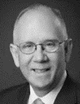



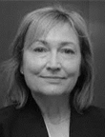

GTMRx National Task Force: Focused on
Building Vaccine Confidence in the Health Neighborhood
Kate Berry
Senior Vice President, Clinical Affairs and Strategic Partnerships, America's Health Insurance Plans
Ernest Grant, Ph.D., RN, FAAN
President, American Nurses Association (ANA)
Ann Greiner
President CEO, Primary Care Collaborative (PCC)
Paul Grundy, MD, MPH, FACOEM, FACPM
Chief Transformation Officer, Innovaccer; President, GTMRx Institute
Doug Henley, MD, FAAFP
Executive Vice President & CEO Emeritus, American Academy of Family Physicians (AAFP)
Connie Hwang, MD, MPH
CMO & Director of Clinical Innovation, Alliance of Community Health Plans
Punam Keller, Ph.D., MBA
Senior Associate Dean of Innovation & Growth, Tuck School of Business, Dartmouth University
Mike Maddux, Pharm.D., DHL (Hon)
Executive Director, American College of Clinical Pharmacy
Darilyn Moyer, MD, FACP, FIDSA, FRCP
Executive Vice President & CEO, American College of Physicians (ACP)
Debra Ness, MS
President, National Partnership for Women & Families

Slide 5
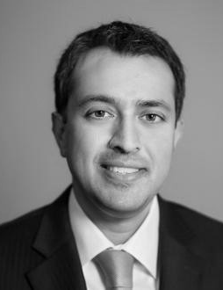

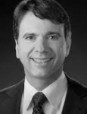



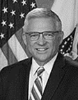




GTMRx National Task Force: Focused on
Building Vaccine Confidence in the Health Neighborhood
Anand Parekh, MD, MPH
Chief Medical Advisor, Bipartisan Policy Center (BPC)
Kathleen Pawlicki, RPh, MS, BPharm, FASHP
Immediate Past President, American Society of Health-System Pharmacists (ASHP)
Marcus Plescia, MD, MPH
Chief Medical Officer, Association of State & Territorial Health Officials (ASTHO)
Chris Queram, MA
Interim CEO, National Quality Forum
Chet Robson, DO, MHCDS, FAAFP
CMO & Medical Director, Office of Clinical Integrity, Walgreens
Julia Skapik, MD, MPH
Medical Director, National Association of Community Health Centers (NACHC)
Richard Stone, MD
Acting Under Secretary for Health, Veterans’ Health Administration (VHA)
Mike Thompson
President & CEO, National Alliance of Healthcare Purchaser Coalitions (NAHPC)
Toyin Tofade, MS, Pharm.D., BCPS, CPCC, FFIP
Dean & Professor, Howard University
Antonia “Toni” Villarruel, Ph.D., RN, FAAN Professor & Dean of Nursing, University of Pennsylvania
Susan Winckler, RPh, Esq.
CEO, Reagan-
Udall Foundation for the Food and Drug Administr-ation

Slide 6
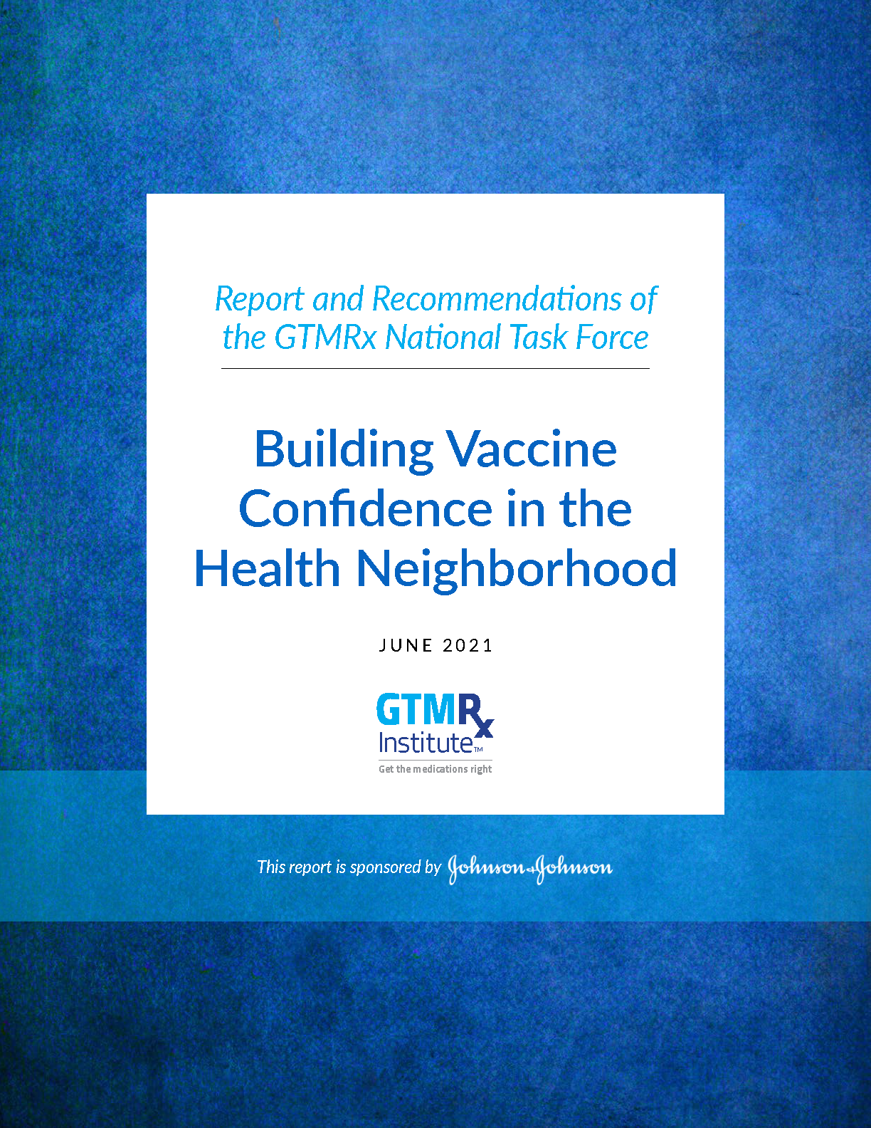
Final Report and Recommendations of the GTMRx National Task Force
The goal of the task force: Inform the strategies to engage teams at the community level to work collaboratively and communicate effectively about vaccination during current and future pandemics by:
Engaging care teams in the local community
Coordinating with schools, religious organizations and employers
Collaborating with local, state and federal agencies
Communicating to ensure effective, efficient and engaged community response
GTMRx believes that the medical neighborhood partnering with the health neighborhood are essential and fundamental when implementing programs to build vaccine confidence today, and in the future.
(Trust + Time = Impact)

Slide 7
Final Report and Recommendations of the GTMRx National Task Force
From April 6 – June 8 Task Force met on 5 to bring forward a set of final recommendations. Final report released June 15, 2021.
Short-term recommendations to boost COVID-19 vaccine confidence for the remainder of 2021 (Vaccine Confidence Leagues)
Long-term recommendations to address vaccine confidence more broadly and enhance health in neighborhoods across the country vaccine

Slide 8

GTMRx National Task Force: Key Considerations
(1) To spare ongoing suffering and death amid the COVID-19 pandemic, it is crucial to get as many people vaccinated as possible in the United States and worldwide.
Given that so many Americans remain hesitant about being vaccinated, it is also critical to boost their confidence in the vaccines.

Slide 9

GTMRx National Task Force: Key Considerations
(2) Communities across the U.S. should bring together a broad group of stakeholders across their local "health neighborhood" through backbone organizations that create robust plans to launch "Vaccine Confidence Leagues" in order to expand uptake and access to vaccines.
These plans should focus on person-to-person outreaches to listen respectfully to, and to address, individuals' concerns.

Slide 10

GTMRx National Task Force: Key Considerations
(3) The "coalitions of the willing" among the various members of the health neighborhood that are created to address vaccine confidence, should continue past the COVID pandemic to advance health in their communities and work to expand utilization and take-up of all adult and childhood vaccines.
- Strengthening immunization information systems (or IIS) and public health infrastructure.
- Creating parity of vaccine supply to all vaccination sites.

Slide 11











What is the “Health Neighborhood”
The broad array of organizations and individuals who have a stake in a given community’s health: Hospitals and health systems, including both civilian institutions as well as those of the military and the Veterans’ Health Administration; primary care physicians and other clinicians and providers, including nurse practitioners and registered nurses, physicians’ assistants, pharmacists and other key health team members; community health centers, including but not limited to Federally Qualified Health Centers; pharmacies; health insurers; employers and local businesses; the local health or public health department and affiliated public health entities; other branches of local government; social services agencies and providers; military and veterans’ organizations; faith-based organizations; civic organizations; schools, school boards and parent/teacher organizations and municipalities; higher education institutions; and other non-health care partners as deemed appropriate.

Slide 12


Collective Impact
Health neighborhoods should unite with the goal of boosting vaccine confidence through “collective impact.” The collective impact model assumes that members will rise above their individual agendas and reach beyond their professional silos and build collective approaches to complex problems.
BACKBONE ORGANIZATION
A coordinating entity that convenes community members and supports and facilitates their collective impact. Various entities, including civic and nonprofit groups and others, may serve as backbone organizations. A backbone organization guides development of a vision and strategy; supports aligned activities; establishes shared accountability and measurement practices; builds public will; advances policy changes when necessary; serves to identify and tap sources of funding and may serve as the fiscal intermediary to obtain funding and channel it to community members.
VACCINE CONFIDENCE LEAGUES
Community organizations across a given health neighborhood that unite to advance vaccine confidence in the local area. These Leagues should focus on person-to-person outreach, mobilizing the efforts of trusted messengers that play key roles in communities. All of these entities should commit to listening respectfully to individuals’ concerns and to addressing them honestly, truthfully, and in an environment of trust, to build vaccine confidence.

Slide 13
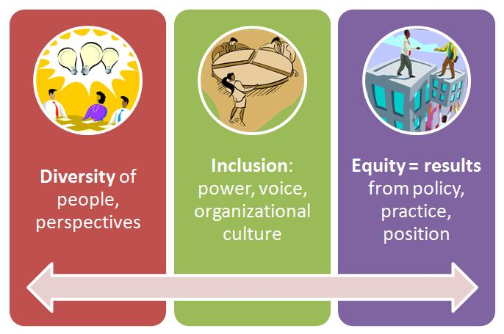
Health Neighborhoods: Vaccine Confidence Leagues Through a Racial Justice Lens
Source: https://interactioninstitute.org/seeing-collective-impact-efforts-with-a-racial-justice-lens/

Slide 14
How Will This Be Done?
Long-Term Recommendations:
The local health neighborhood coalitions and Vaccine Confidence should continue to advance access to, uptake and use of all adult and childhood vaccines and to address other health needs in their communities.
Because it is likely that new vaccines will be developed rapidly in the future, vaccine developers and the US Food and Drug Administration should work to limit the amount of time that vaccines are subject to emergency use authorization (EUA) and speed the appropriate final market approval of vaccines. Doing so will mitigate public concerns that EUA authorization entails regulatory oversight that is not as rigorous as final approval. In addition, the FDA and others should take steps to educate the public about vaccine studies and the development and approval process.
The federal government and states should undertake broad measures to improve and connect the nation’s multiple immunization information systems (IIS) to create a more robust, real-time national vaccine information infrastructure. States should adopt consistent standards for which providers are required to report information about vaccinations, and providers should have greater capability to query systems to determine who has been vaccinated.

Slide 15
How Will This Be Done?
Long-Term Recommendations:
The Affordable Care Act mandates that all vaccines recommended by the CDC’s Advisory Committee on Immunization Practices (ACIP) be provided by all commercial health insurers and self-insured health plans at no out-of-pocket costs to beneficiaries. Nonetheless, consumer cost-sharing for vaccines is still a reality for many. The executive branch and Congress should enact legislation to bar all cost-sharing by beneficiaries of any public health insurance in the United States for receipt of any ACIP-approved vaccines.
Providers administering vaccines may be paid very different rates by public and private health plans, depending on the type of provider and negotiated provider contract rates. Federal and state officials should examine these overall systems of payment to providers for vaccine administration and determine equitable formulas that are consistent with the notion that there should be broad access to and administration of vaccines.
Vaccine deliveries to some locations, such as large health systems or public health agencies or retail pharmacies, are often prioritized over deliveries to others, such as smaller primary care practices. The federal government and states should work with state and local governments and vaccine distributors to eliminate these disparities in vaccine deliveries in the interests of assuring broad vaccine access.

Slide 16
How Will This Be Done?
Long-Term Recommendations:
Multiple policy proposals to advance childhood immunizations should be adopted, as follows:
  All nonmedical exemptions—personal, philosophical or religious—from immunization requirements for children should be eliminated at the state level, as supported by the groups cited here by the Immunization Action Coalition.
  Once COVID-19 vaccines receive emergency use authorization for administration to children below age 12, states should initiate pilot programs to vaccinate children in schools and develop evidence over time to determine whether adding COVID-19 vaccines to the list of state-required childhood vaccination is appropriate. The CDC’s Advisory Committee on Immunization Practice, ACIP, should also consider this question and issue its recommendation as soon as practicable.

Slide 17
Want to Learn More?
Visit or website or contact us!
gtmr.org
info@gtmr.org | (703) 394-5398

